Slide 1


Sarvajanik Education Society Sarvajanik College of Engineering & Technology, Surat. Master of Computer Applications Academic Year: 2024– 25
A Project On
Railway Ticket Booking System
Presented By
PATEL DISHANK KUMAR NITINBHAI (ET24MTCA043)
PATEL VIVEKKUMAR ROSHANBHAI (ET24MTCA054)
PATEL DHRUV RAJESHBHAI (ET24MTCA041)
SONI ANANT RAJESHKUMAR (ET24MTCA064)
M.C.A. I Sem. 1
Under the Guidance of
Prof. Margee Rawal

Slide 2
2
AGENDA
Project Abstract
Objective
System Description (Technologies used)
Database Design/ File System (Table Designs)
Diagrams (Use Case Diagram, Activity Diagram).
Limitation
References

Slide 3
3
1. Project Abstract
The Railway Ticket Booking System is a console-based application.
It automates and streamlines the ticket reservation process for railway systems.
Developed using the C programming language.
The project demonstrates fundamental programming concepts like file handling, data structures, and user interface creation.
Features of the system include ticket booking, and ticket status checking.
It aims to provide an efficient, user-friendly, and accessible solution for basic railway reservation needs.

Slide 4
4
2. Objective
Ticket Booking
Secure User Registration
Destination Selection Options
Display Ticket Details
Centralized Admin Management
Restricted Access for Security
Enhance Learning in C Programming

Slide 5
5
3. System Description (Technologies used)
Language | C Language
Operation System | Windows 11
Tools | Dev C++

Slide 6
6
4. Database Design/ File System (Table Designs)
Admin Database Design :
Admin Register | Admin Login
Admin Full Name | Admin Email Id
Admin Contact Number | Admin Password
Admin Address
Admin Email Id
Admin Password
Admin Repeat Password

Slide 7
7
User Database Design:
User Register | User Login
User Full Name | User Email Id
User Contact Number | User Password
User Address
User Email Id
User Password
User Repeat Password

Slide 8
8
Ticket Booking Database Design:
Tourist Name
Tourist Age
Select Destination
Select Coach [AC & Non-AC]
Select Food [Veg & Non-Veg]
Counts of Tickets
Show Ticket Price
Payment Process
Payments Amount
Payment Id
Payment Process

Slide 9
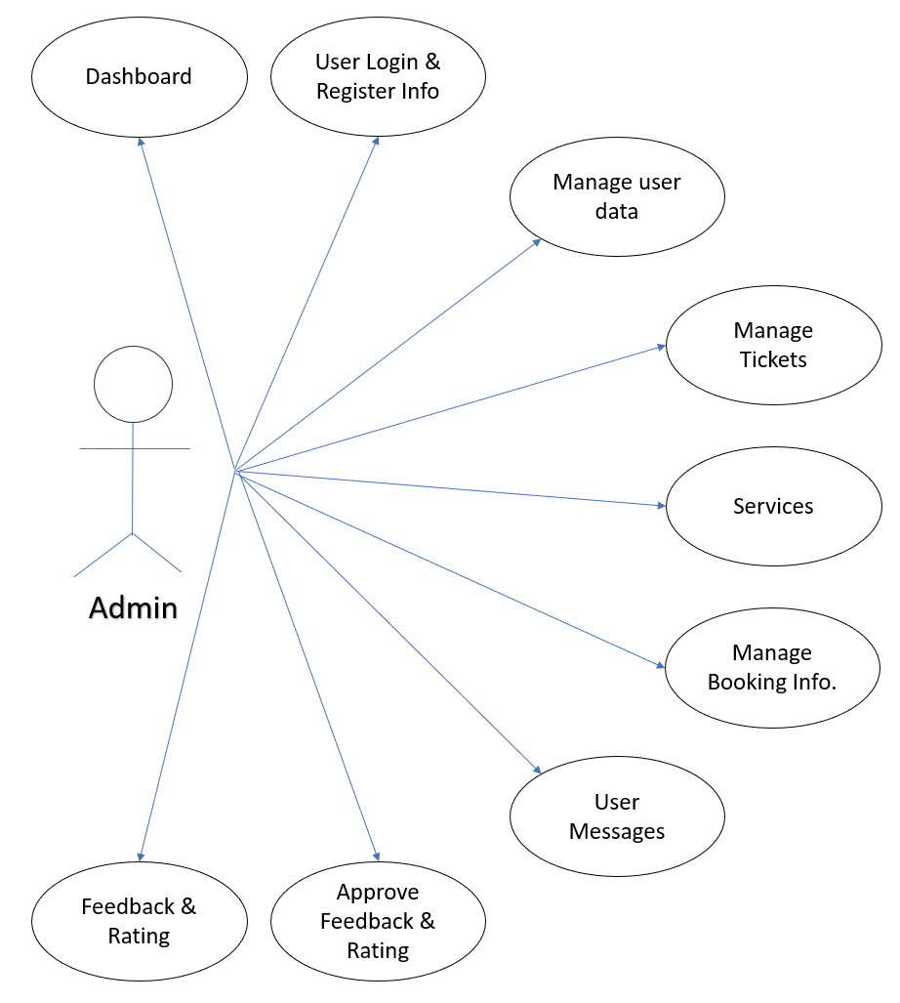
Admin Use-case diagram

Slide 10
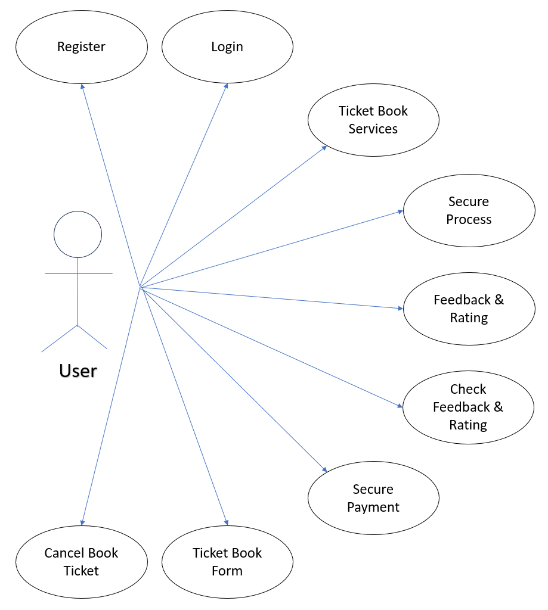
User Use-case diagram

Slide 11
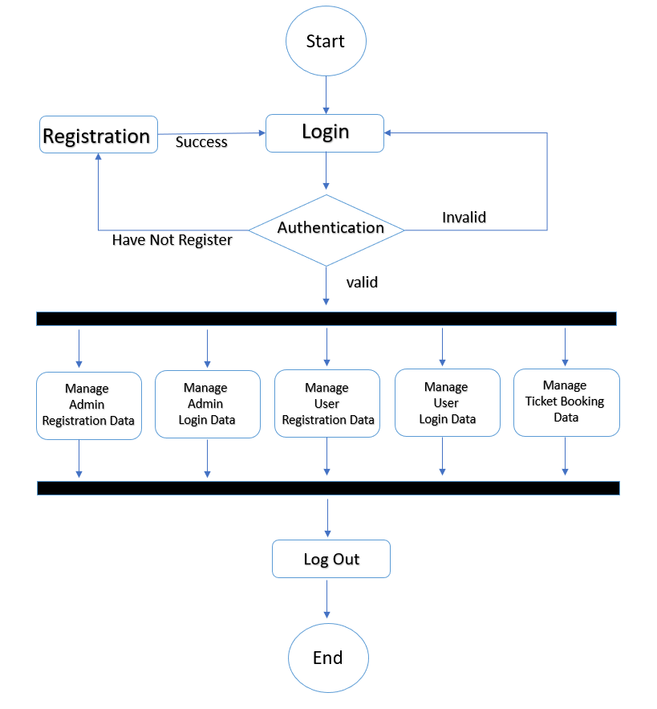
Admin
Activity diagram

Slide 12
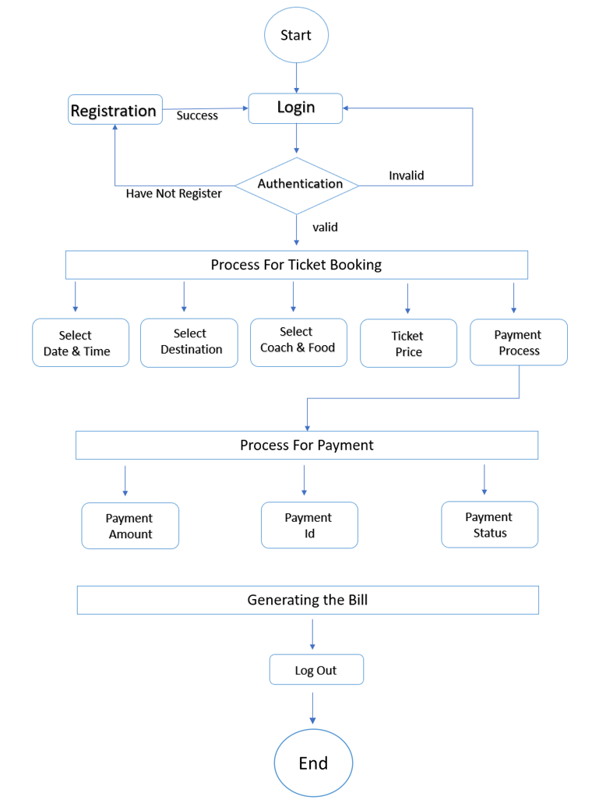
User
Activity diagram

Slide 13
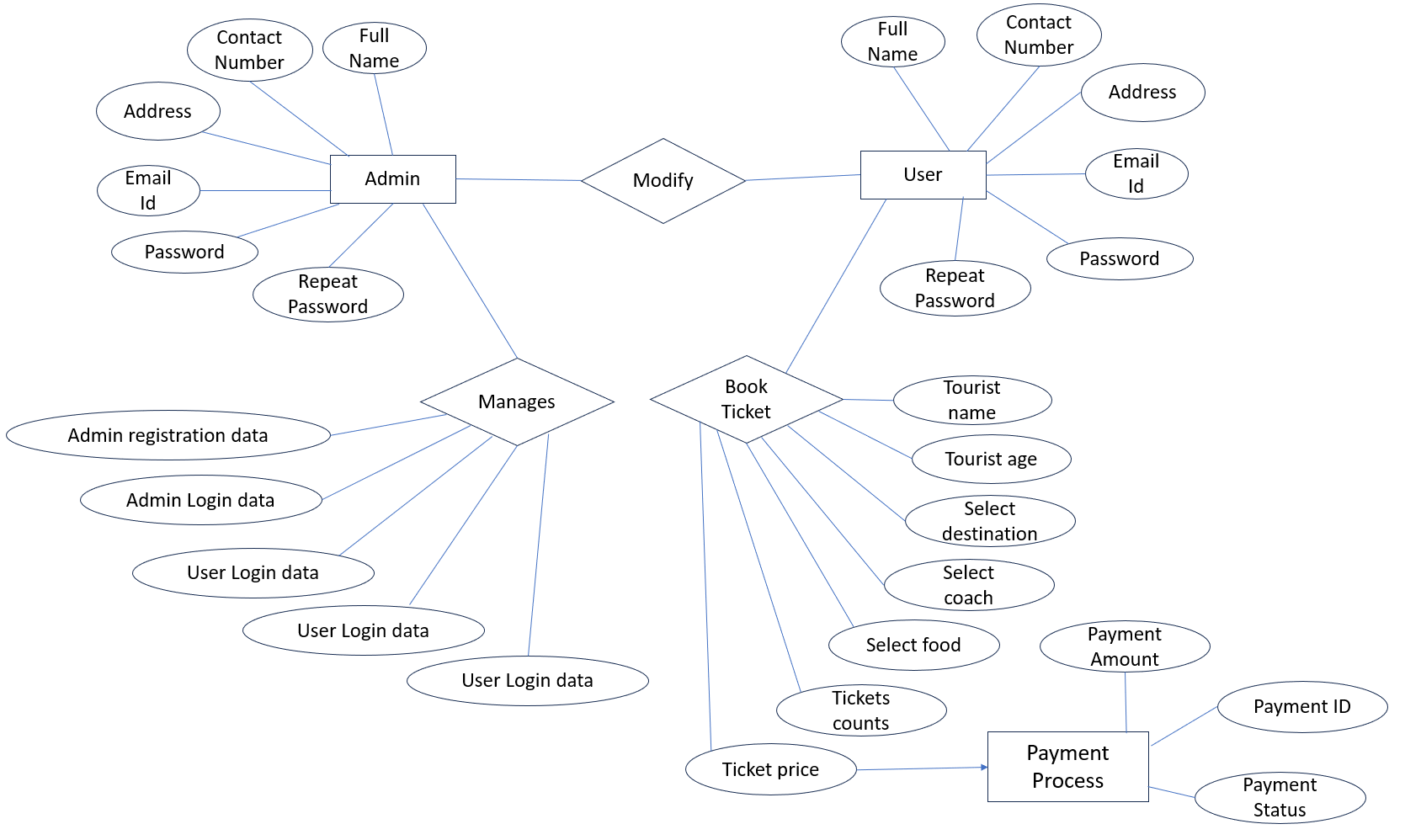
ER diagram

Slide 14
14
5. Limitation
Lack of Real-Time Seat Management
Security Concerns
Lack of Ticket Cancellation
Absence of Payment Integration System
Basic User Interface
Lack of Input Validation
Lack of Train Schedule or Timing Data
No Multi-User Support
No Ticket Customization Options

Slide 15
15
6. References
www.studytonight.com
www.drawio.com
www.cppreference.com
www.scaler.com/topics/c/file-handling-in-c/

Slide 16
16
Thank You

